Slide 1



CMPUT 175
Introduction to Foundations of Computing
ADT: Abstract Data Types
You should view the vignettes:
Abstract data Types
Concept of Encapsulation
Encapsulation, the Gearbox example
Stacks
Post-test

Slide 2

Objectives
In this lecture we will discuss Abstract Data Types.
We will talk about data structures, the implementation of Abstract Data Types.
We will learn how to create data types and describe their properties and operations independently of any implementation

Slide 3
Data Types
You are by now acquainted with data types like Integers, Strings, Booleans, and so on.
To access the data, you use operations defined in the programming language (Python) for the data type.
For instance by accessing list elements in Python, you would use the square bracket notation myList[i]

Slide 4
Type Definitions
Selecting a type for a variable determines the possible values for that variable; the operations that can be done on it; and the meaning of the data.
We might want to define data with complex data structures that are not readily provided by the programming language
We might want to enrich the behaviour (operations) of an existing data type.
© Osmar R. Zaïane : University of Alberta

Slide 5
The need for more data types
Software evolve as a result of new requirements or constraints.
A modification to a program commonly requires a change in one or more of its data structures
a new field might be added to a personnel record to keep track of more information; a list might be replaced by a some other structure to improve the program's efficiency
© Osmar R. Zaïane : University of Alberta

Slide 6
The need for isolation
If a data structure is changed or it’s behaviour (interface) enhanced due to Software evolution or new requirements, maintenance of the software can become expensive if we need to revisit all the program
By separating the implementation of a data structure and its behaviour from the implementation of the program that uses this data structure we minimize impact of change.
You don't want a change in a data structure to require rewriting every procedure that uses the changed structure.
© Osmar R. Zaïane : University of Alberta

Slide 7

Abstract data types
What does ‘abstract’ mean?
We make abstraction of the implementation of the data structure
We hide the details of the implementation and show only the possible operations (interface)
We talk about encapsulating the data structure
Implementation of data structure
Access the data via interface (behaviour) and never directly to data structure implementation
Implementation of behaviour

Slide 8

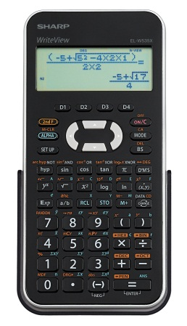
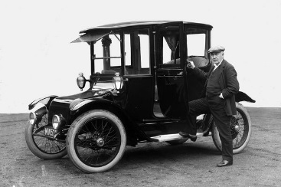


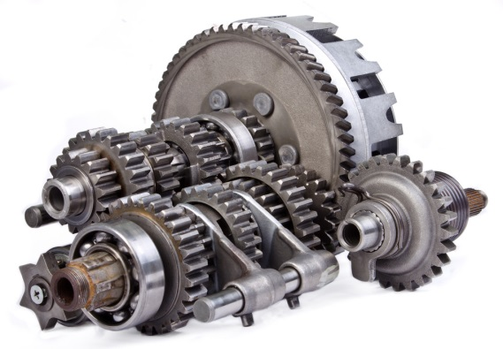
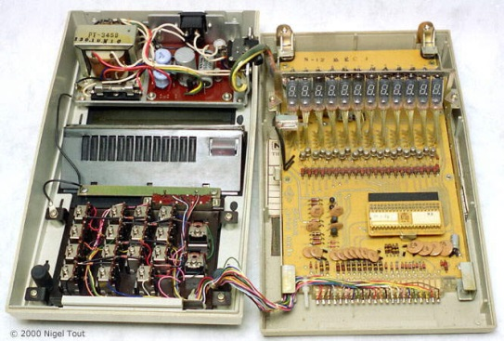



Concrete examples
You don’t need to know how the engine works, the mechanics of the gearbox, etc. in order to drive the car.
You don’t need to know how calculators handle operations in order to use the calculator for even complex reckoning.
You don’t need to know how the phone does establish connections and transmits voice in order to use it.
You need to know how to use the clutch and how to shift gears, etc.
You need to know how to operate the provided buttons and functions, etc.
You need to know how to dial and where is the speakerphone and the microphone, etc.
Interface
© Osmar R. Zaïane : University of Alberta

Slide 9

ADT Example: Floating point numbers
You don't need to know how floating point arithmetic is implemented to use float
  Indeed, the details can vary depending on processor, even virtual coprocessor
  But the compiler hides all the details from you--some numeric ADTs are built-in
  All you need to know is the syntax and meaning of operators, +, -, *, /, etc.
Hiding the details of implementation is called encapsulation (data hiding)
Float
Result
Operator

Slide 10

Other Existing encapsulated structures
Python provides a built in structure list
  You do not need to know how Lists are implemented in order to use them.
  All you need to know is the interface, the set of provided methods to use and manipulate the list
list.append(x) Add an item to the end of the list;
list.extend(L) Extend the list by appending all the items in the given list;
list.insert(i, x) Insert an item at a given position.
list.remove(x) Remove the first item from the list whose value is x.
list.pop([i]) Remove the last item in the list or the item at the given position in the list, and return it.
list.index(x) Return the index in the list of the first item whose value is x.
list.count(x) Return the number of times x appears in the list.
list.sort() Sort the items of the list, in place.
list.reverse() Reverse the elements of the list, in place.

Slide 11
ADT = properties + operations
An ADT describes a set of objects sharing the same properties and behaviors
  The properties of an ADT are its data (representing the internal state of each object
    double d; -- bits representing exponent & mantissa are its data or state
  The behaviors of an ADT are its operations or functions (operations on each instance)
    sqrt(d) / 2; //operators & functions are its behaviors
Thus, an ADT couples its data and operations
  OOP emphasizes data abstraction
12.987654321 → 12987654321 x 10⁻⁹

Slide 12
Formal, language-independent ADTs
An ADT is a formal description, not code; independent of any programming language
  Why is code independence a good idea?
Promotes design by contract:
  Specify responsibilities of suppliers and clients explicitly, so they can be enforced, if necessary

Slide 13
Example: Bags and Sets
Simplest ADT is a Bag (sets with duplication)
  items can be added, removed, accessed
  no implied order to the items
  duplicates allowed
Set
  same as a bag, except duplicate elements are not allowed
  union, intersection, difference, subset

Slide 14
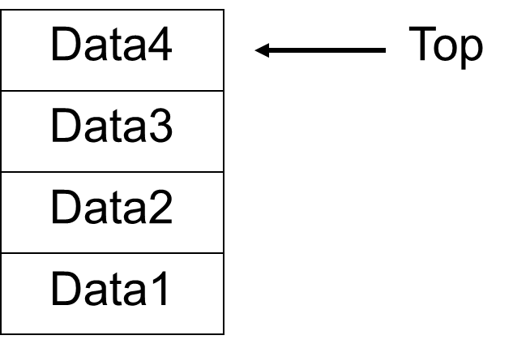
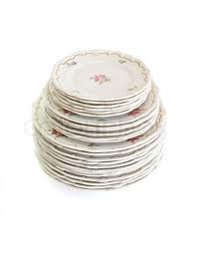


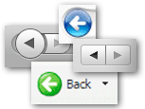
Example: Stacks
Collection with access only to the last element inserted
Last in - first out (LIFO)
  Add element: push
  Remove element: pop
  top
  is empty
  make empty
New Data
Data5
Push
Pop
Think of when you are browsing the web. The browser pushes the visited URLs on a stack. The back button pops them back.

Slide 15
Other examples of ADT
Lists
Queues
Deque
Pile (sorted deque)
Trees
Heaps
Binary search trees
B trees
Maps
Graphs
…

Slide 16
Abstraction and Implementation
ADT represents a specification
  Cannot be used directly in programming
The physical implementation of an ADT is referred to at Data structure
  Data Structure=Implementation of ADT
In O-O programming, the implementation of choice for an ADT is the creation of a new class
  Methods implement behaviour (operations)

Slide 17
Data Structures
A Data Structure is:
  an implementation of an Abstract Data Type and
  "An organization of information, usually in computer memory", for better algorithm efficiency."
List Object
aList
5
size
myElements
0 1 2 3 4 5 6 7 8 9 10
A C E B A

Slide 18
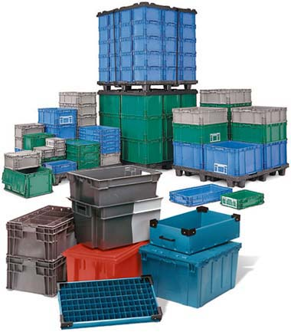
Data Structure Concepts
Data Structures are containers:
  they hold data
Different types of data structures are optimized for certain types of operations
Linear data structures are containers of data collections with ordered items. They differ on how items are added and removed.
Linear structures have two ends: Front and Rear (or Top and Bottom) (or Head and Tail)
Linear structures are containers that differ on the location their items are added or removed

Slide 19
Core Operations
Data Structures will have 3 core operations
  a way to add things
  a way to remove things
  a way to access things
Details of these operations depend on the data structure
  Example: List, add at the end, access by location, remove by location
More operations added depending on what data structure is designed to do
Mutators or setters
Accessors or getters

Slide 20
Mutator and Accessor
A mutator method is a method used to control changes to a variable
It is also called a setter because it sets the value of a variable.
Based on the principle of encapsulation a member variable of a class is made private to hide and protect it from other code.
A public mutator method gets a new value as parameter, validates it (optionally) and assigns it to the private member variable.
An accessor method returns the value of a member variable without altering it.
It is also called a getter because it gets the value
© Osmar R. Zaïane : University of Alberta

Slide 21
ADTs and Data Structures in Programming Languages
Modern programming languages usually have a library of data structures
  Java collections framework
  C++ standard template library
  Python lists, tuples, sets and dictionaries
  Lisp lists

Slide 22




Object Concepts
Remember:
The implementation of choice for an ADT is the creation of a new class.
An object has:
  A private state
  A set of resources that it provides. Let’s call this its public protocol
Each object is an instance of a class.
The class defines the public protocol, so all objects of a class have the same protocol.
The state of an object differentiates it from other objects in the same class.
Class stickman
Instances of class stickman

Slide 23
Object Class, Protocol and State
class
external request
Private state
Public protocol

Slide 24
What getters and setters should not do
To enforce encapsulation and data hiding, it is bad practice to have getter and setter methods expose the members properties (private state of objects).
The exposed methods (public protocol) should act on the object to change its private state (setter or mutator) or act on the object to provide its data (getter or accessor) without exposing its implementation or properties.
Outside the class, only the interface is known, while the implementation of the data structure is unknown (hidden).
© Osmar R. Zaïane : University of Alberta

